Slide 1
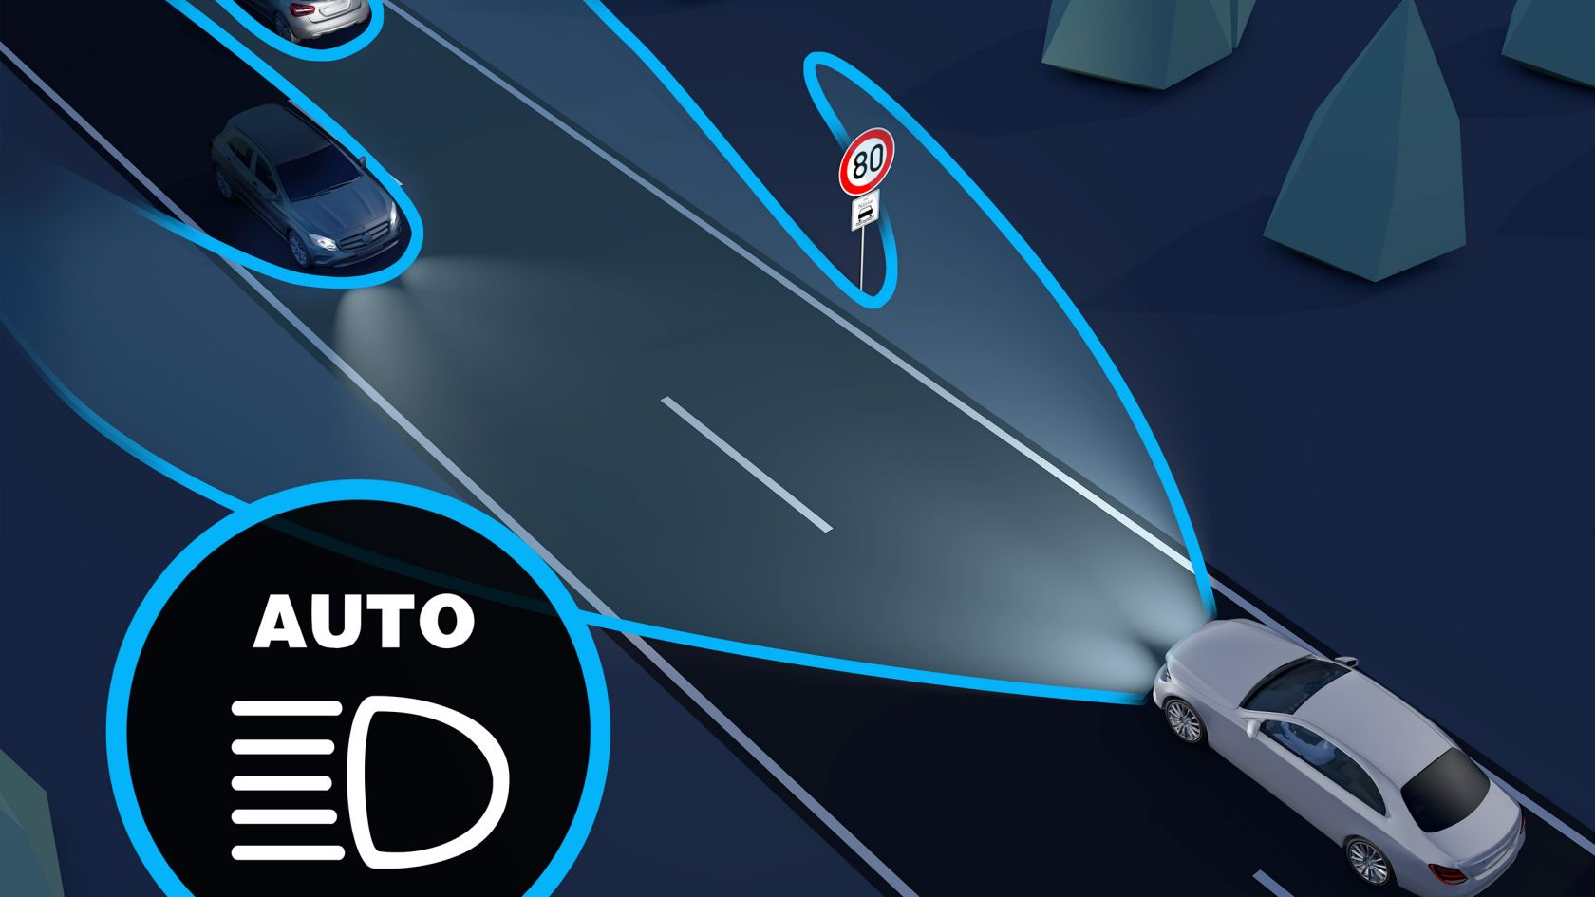

Autonomous Vehicle group
School of ECE
Minor project on
An Adaptive Driving Beam(ADB) System based on Angle and position information of opposite vehicle
Team-16
Student details :
RAJASHEKHAR GANIGER :01FE20BEC205
REVATI KARALATTI : 01FE20BEC092
VISHAL KULKARNI : 01FE20BEC192
ABHISHEK KUDACH : 01FE20BEC192
Under the guidance of:
Prof. Heera .G. wali

Slide 2
Contents :
Introduction
Literature survey
Need statement
Problem statement
Functional block diagram
Data sets/Data Acquisition
Flowchart
Result

Slide 3
Introduction :
The headlamps in most of the vehicles today are controlled manually, with a large percentage of drivers switching not between high and low beam which often results in accidents when the illuminated light causes momentary blindness in the driver advancing in the opposite
direction, or reflections from the mirrors in case if the other vehicle is ahead. This is called the Troxler’s effect. The chances of havoc due to these are further pronounced if the pathway is a curve or uphill. Also, the typical low beam frameworks do not brighten the correct way on
bent roads, resulting in an increased number of accidents involving pedestrians

Slide 4
Motivation:
The primary driving force behind this initiative is to advance vehicle security, which is currently a top priority for the automotive industry.There are more technique to reduce accident at day time when compared with night time .According to a report from the National Highway Traffic Safety Administration (NHTSA), almost 50 percent of fatal car accidents happen at night, despite the fact that only about 25 percent of vehicle travel takes place during the night hours.While driving a car, there are many parameters that have to be kept in check to avoid accidents and sometimes these parameters become one too many for the driver but an adaptive headlight(automated machine) can handle things perfectly.Adaptive LED headlights are able to adapt to various road conditions. The benefits of adaptive LED headlights include Increased Visibility,Less Distracted Driving and Safety.A large number of lives can be saved by making use of autonomous vehicles. The detection feature in autonomous vehicles is very helpful to the system in making decisions about its intended course and final destination. This project’s significance and the effects it will have on autonomous vehicles are its main sources of inspiration.

Slide 5
Literature Survey :
SR.NO | TITLE | AUTHOR | SUMMARY
1 | Adaptive LED Matrix High Beams (June 07,2022 ) LINK : Adaptive_Headlamps_in_Automobile_A_Review_on_the_Models_Detection_Techniques_and_Mathematical_Models.pdf | Can Ozcivelek | It analyzes the road and the pretrained model recognizes vehicles (basically headlights and taillights) model trained using ssd_inception_v2_coco provided by Tensorflow. 2. The LED module consists of 64 individual LED chips but for this project, only 32 of them are reserved for the "high beams", whereas the remaining 32 can be considered as low beams which are always turned ON. 3. The area of detected vehicles are dynamically kept dark, while remaining areas are kept illuminated by the high beams

Slide 6
SR.NO | TITLE | AUTHOR | SUMMARY
2 | Adaptive Headlamps in Automobile: A Review on the Models, Detection Techniques, and Mathematical Models (june 23, 2021) LINK :Adaptive_Headlamps_in_Automobile_A_Review_on_the_Models_Detection_Techniques_and_Mathematical_Models.pdf | G. Toney, C. Bhargava: | 1. An automatic front light systems framework ensures better visibility to drivers by carrying the beam projections as the vehicle traverses . 2. Using an AFS system, the beam lobes of the headlamp are varied according to the side where the vehicle takes a turn to improve the drivers’ perceivability of the road and avoid accidents. involving pedestrians or other objects. 3. This framework is a simple system that controls the headlamp divergence using a stepper motor.

Slide 7
SR.NO | TITLE | AUTHOR | SUMMARY
3 | An Adaptive Driving Beam System based on the Angle Information of the Opposite Vehicle (June 07,2021 ) LINK : deng2021.pdf | Yida Deng1 ,Zhongxu Guan2 ,Hang Zhang2 ,Wenbo Zhao1 ,Bin Wu1 ,Xiaolong Wang, Geyu Lu1 | 1. This automatic adjustment technique can modify the lighting shape of the high beam according to the position of the opposite vehicle, which can prevent dazzling and improve the safety when driving on road. 2. In this paper, an angle detecting ADB technique is proposed, which can calculate and predict the angle of the vehicle coming from the opposite road and turn off the corresponding LEDs to avoid causing dazzling. 3. The adaptive beam adjustment algorithm is analyzed and simulated by MATLAB, and is implemented on a NXP S32K144 platform. 4. CAN bus is introduced to transmit the controlling instruction to the LED matrix in the headlight. 5. The designed ADB system can extremely reduce the risk when driving at night and has a broad prospect in the future automotive market.

Slide 8
Best Solution :
Adaptive LED Matrix High Beams
Justifications :
The LED module consists of 64 individual LED chips but for this project, only 32 of them
are reserved for the "high beams", whereas the remaining 32 can be considered
as low beams which are always turned ON. So we are dealing with 32 LED chips
in 4 rows and 8 columns. To provide a glare-free environment for other drivers,
the 32 LEDs are divided into 8 columns all of which can be individually turned ON/OFF.
If more than 2 vehicles are detected, high beams are turned OFF altogether as the existing 8 columns would be divided too much to the point where the efficiency of illumination would be lost.
The object detection model is capable of recognizing both oncoming and preceding vehicles and works with different types of vehicles (cars, trucks, buses etc.)

Slide 9
Need Statement :
Control the glare(harsh uncomfortable light) coming from the headlight
illuminate as much of the road as possible while not dazzling other drivers for both oncoming and preceding traffic
Proper brightness control for the headlight
Model expectations
To achieve needs in reduced size as much as possible
Improved efficiency
Trained model for all possible cases

Slide 10
Problem Statement :
To develop an appropriate solution for headlight high beam that avoids glare using machine learning algorithm, to demonstrate how the flexibility of LEDs can be used to create safer driving environment under low light/dark conditions. The main objective of this technology to illuminate as much of road as possible while not dazzling other drivers.
Needs achieved from model:
Flexibility to headlight
Able to detect oncoming vehicle
Locate the detected vehicle and decide where to lighten/dark the light

Slide 11
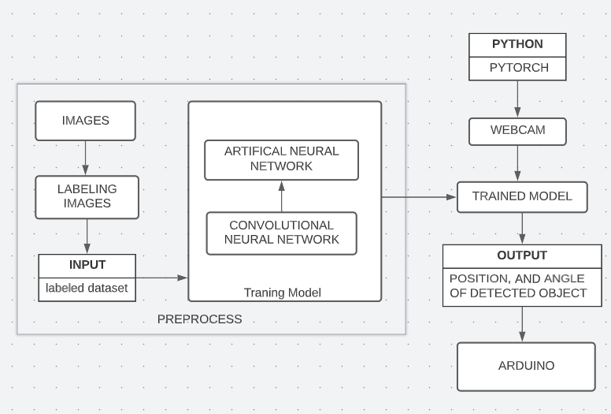
System design:
Functional block diagram :

Slide 12
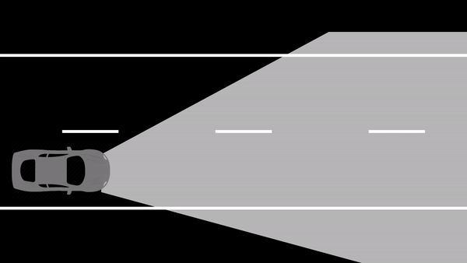
Final design:

Slide 13
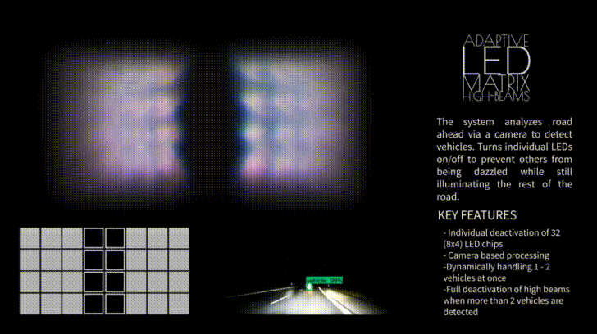

Slide 14






Model Specifications:
Python 3.6 or higher with Numpy , Keras, Opencv library installed
Pytorch==1.9.0,Torchvision==0.10.0
Arduino IDE
Headlight projector lens, LED matrix
Arduino Mega 2560 microcontroller
Label img website for annotation

Slide 15
Algorithm :
1. Train the model to detect vehicles in dark
2. Estimate the vehicles position and determine the appropriate angle
3. The 8x8 LED matrix and servo motor is attached to Arduino mega as a peripheral,
the position and angle data is sent to Arduino and output is processed
4. Transmitted angle is evaluated to determine which headlight should be turned
on or off

Slide 16
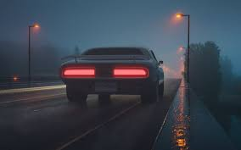
Data set/Data Acquisition :
1k Images including night view of cars with headlight and tail-light
Images are labeled using Label Img
images are separated into train (80%) and test (20%) datasets
Training_Data/
| image1.jpg
| image1.xml
| image2.jpg
| image2.xml
| ...
Validation_Data/
| image3.jpg
| image3.xml
| image4.jpg
| image4.xml
| ...
car

Slide 17
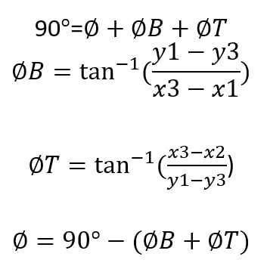

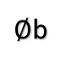
Angle calculation:
For one Vehicle:
(x1,y1)
(x2,y2)
(x3,y2)
(x4,y2)
$∅$b
∅a
∅4
∅3
∅1
∅2
(x1,y3)
(x3,y3)
(x4,y4)

Slide 18
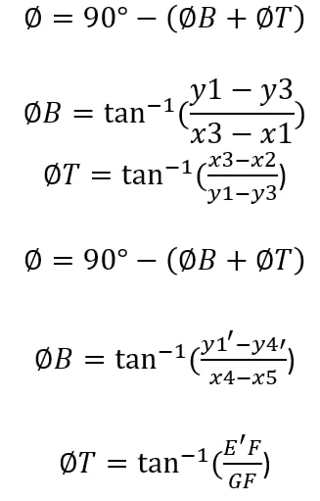
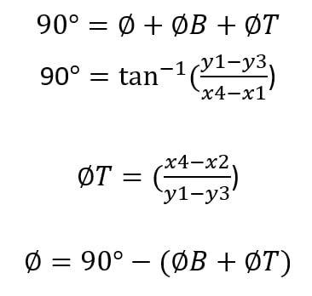
For more than one vehicle:
(x1’,y1’)
(x2’,y2’)
E
E’
F
(x1,y1)
(x2,y2)
∅b
∅a
∅4
∅3
∅1
C
∅2
G
H
(x1,y3)
(x3,y3)
(x4,y4)

Slide 19
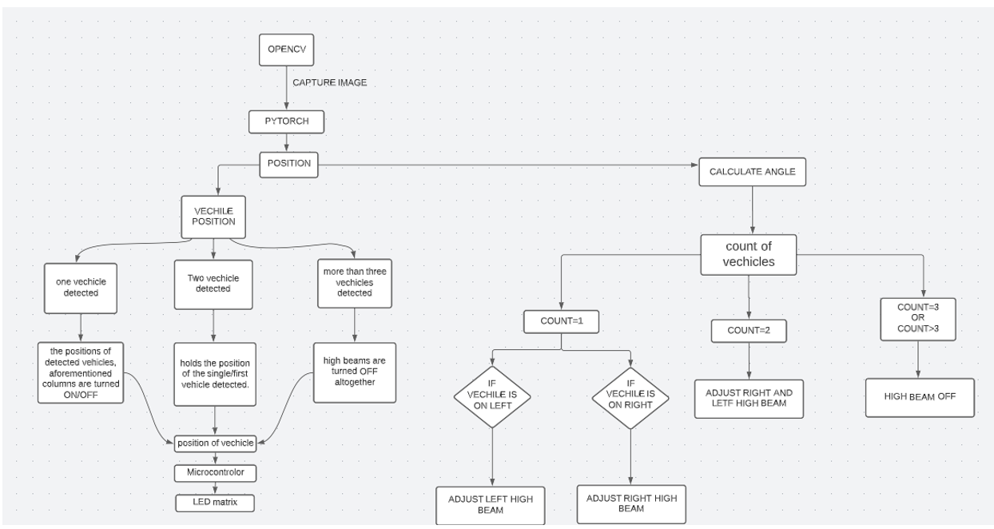
Flow chart:

Slide 20
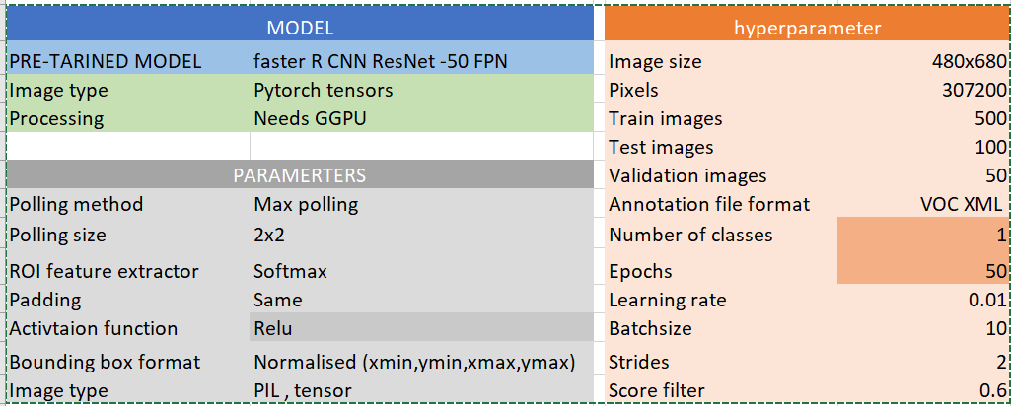
Implementation Details

Slide 21
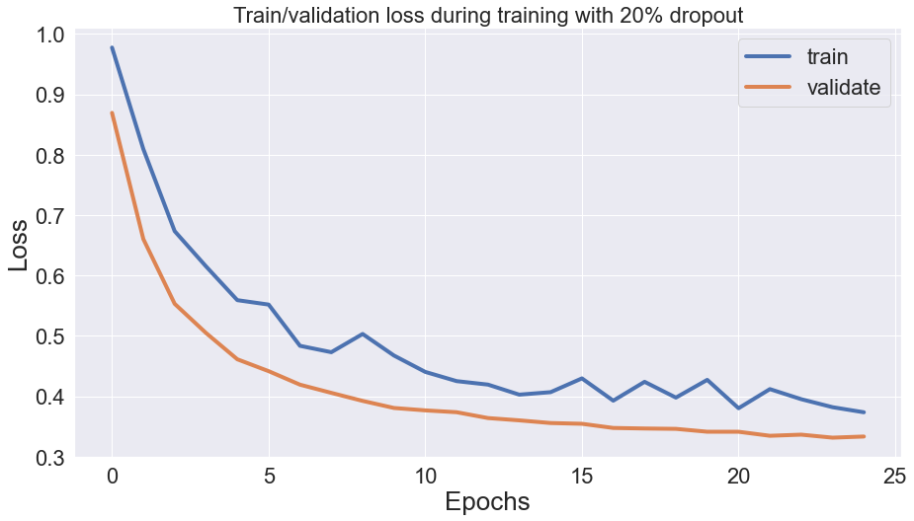
Model evaluation:
Training loss:
A model is better the lower the loss unless the model has over-fitted to the training data). The model’s performance for these two sets is used to interpret the loss, which is determined using the training and validation data. Loss is not a percentage, in contrast to accuracy. It represents the total number of mistakes committed for every example in the training or validation sets.

Slide 22
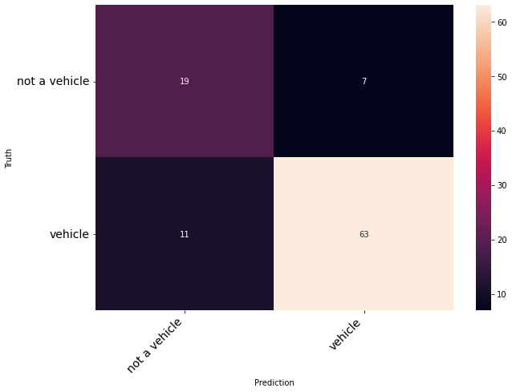
Confusion matrix:
The confusion matrix is a performance statistic for machine learning classification tasks where the output can be two or more classes. The table contains four possible combinations of predicted and actual values.
not a vehicle
Vehicle
not a vehicle
Vehicle

Slide 23
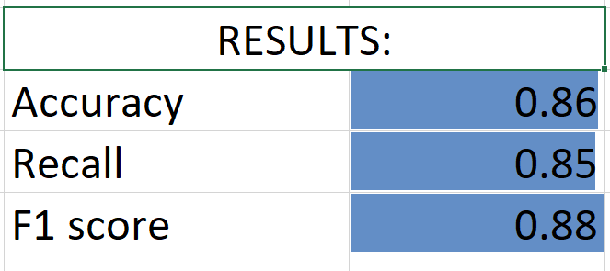
Results:

Slide 24
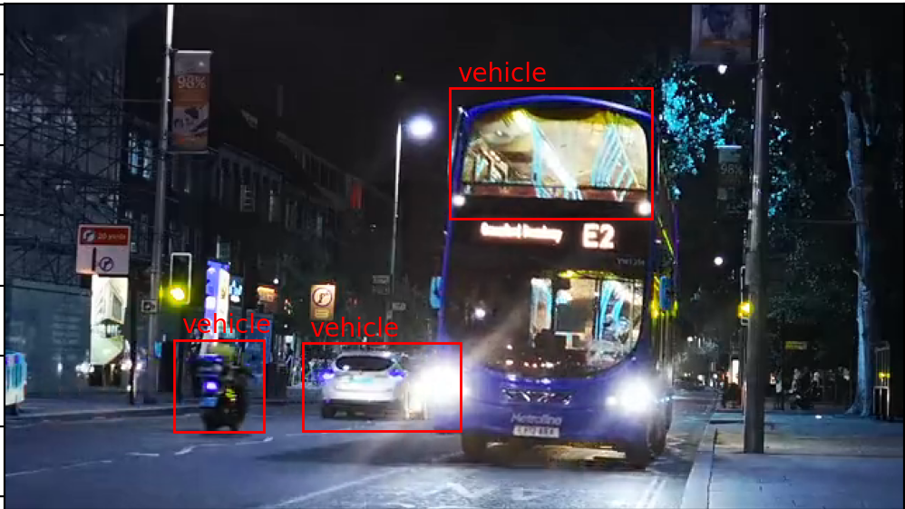
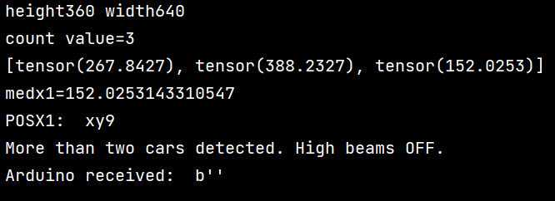

Slide 25
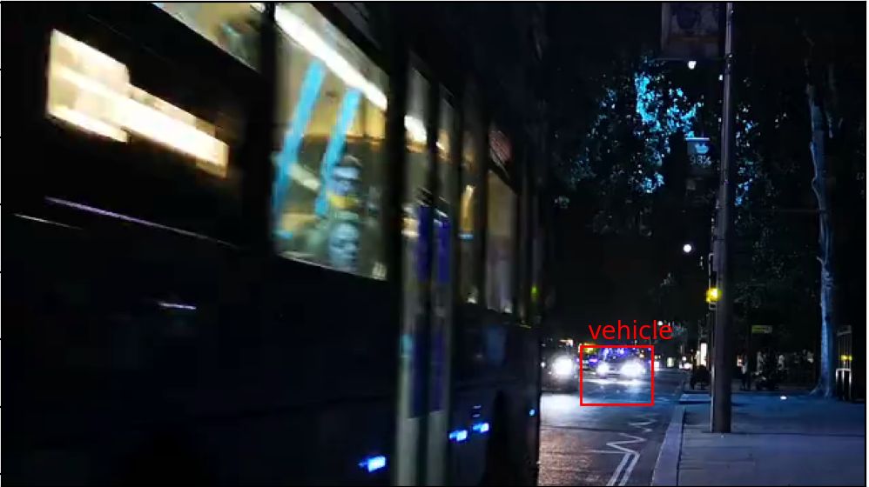
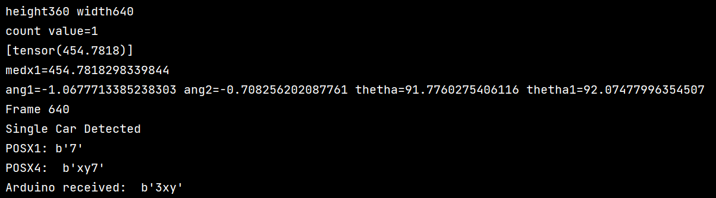

Slide 26
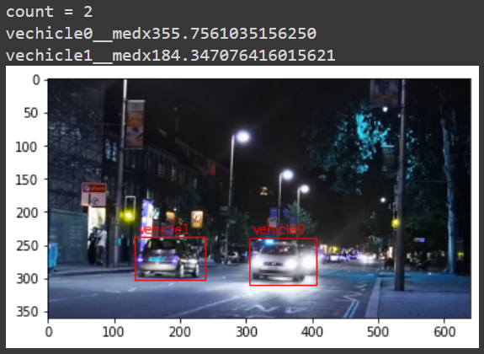
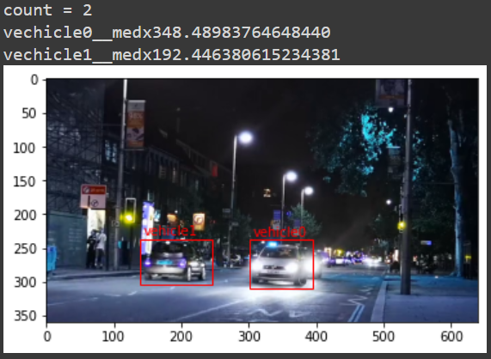

Slide 27
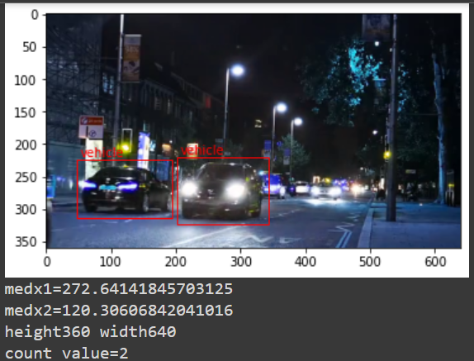


Slide 28
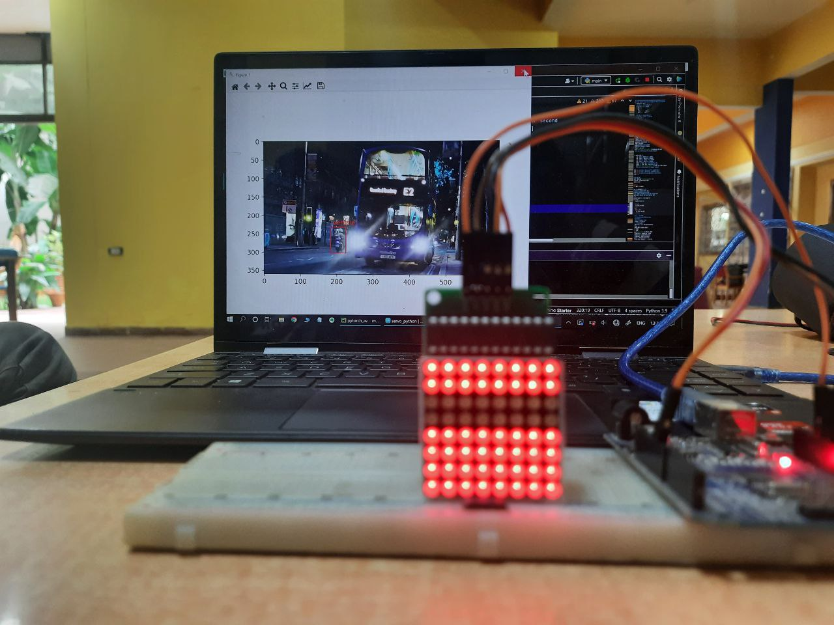

Slide 29
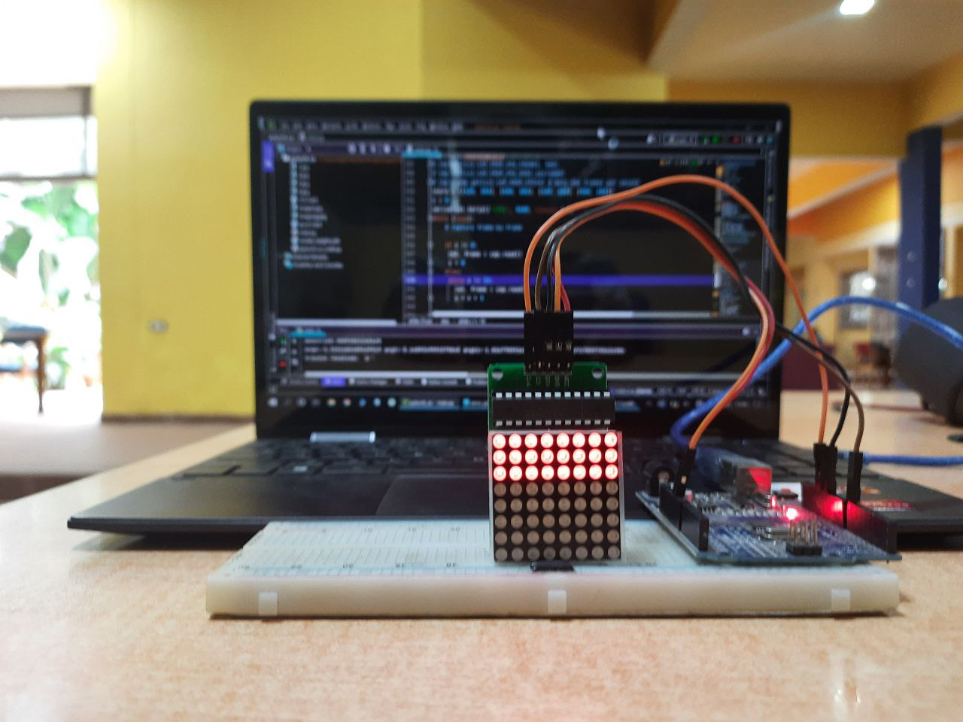
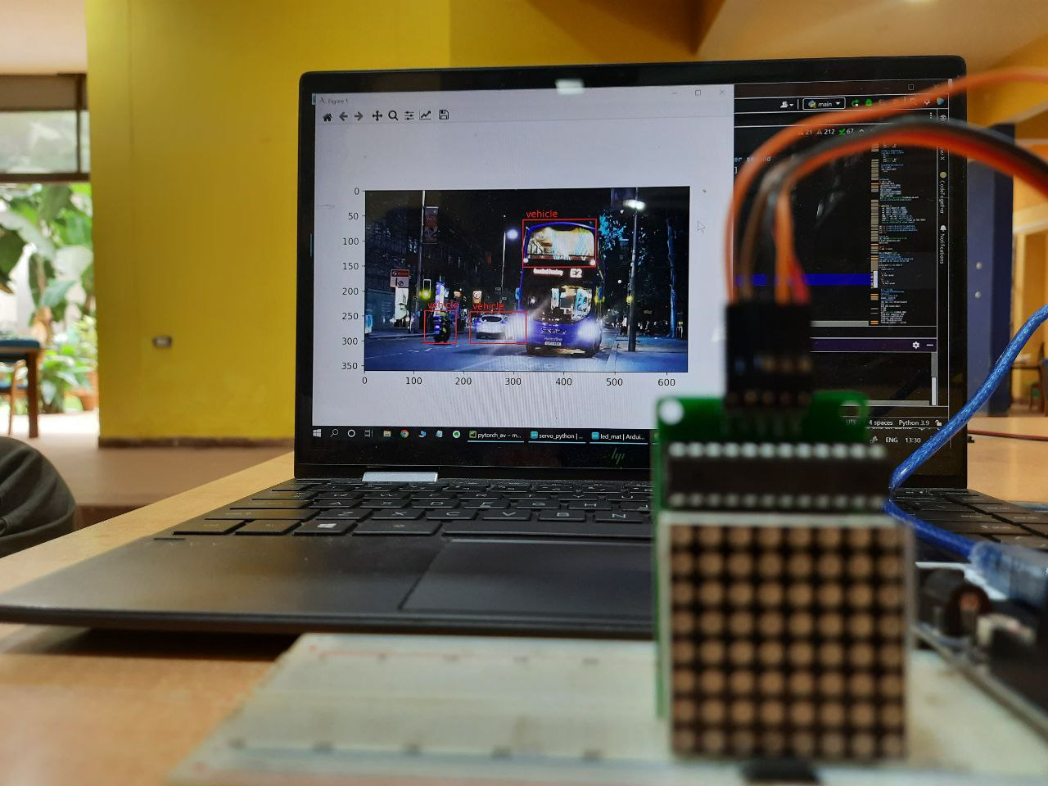

Slide 30
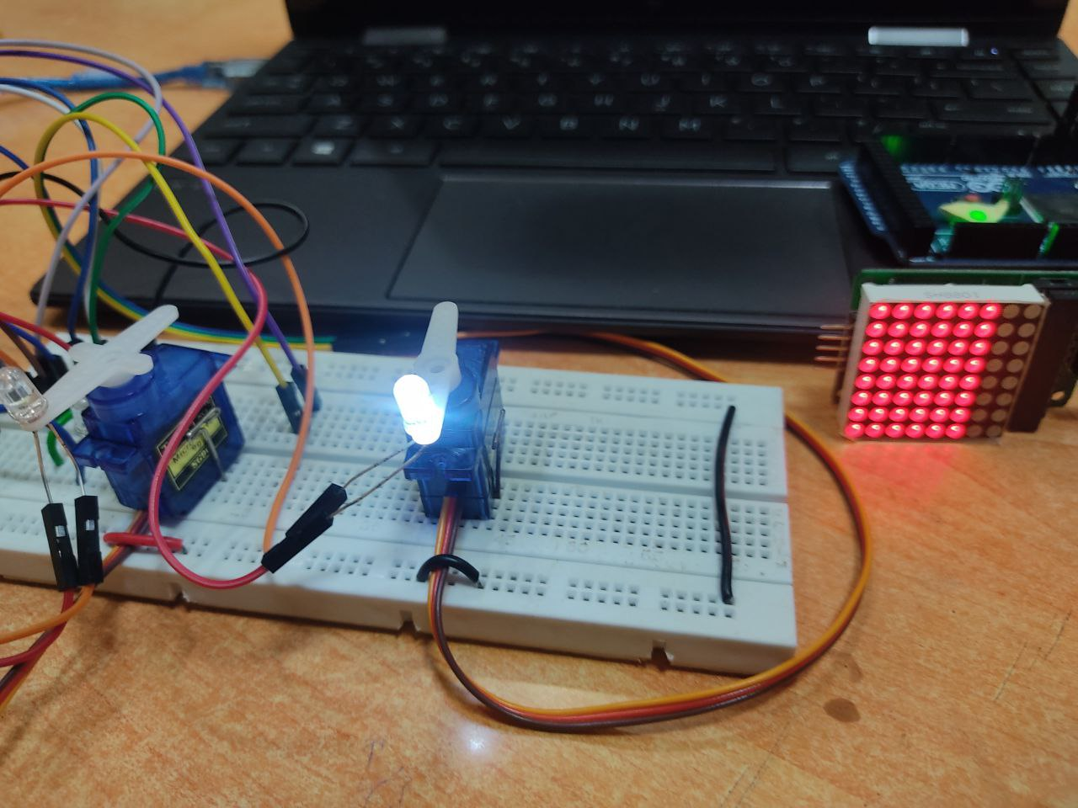

Slide 31
REFERANCE LINKS :
A Method for On-road Night-time Vehicle Headlight Detection and Tracking :
https://drive.google.com/file/d/1M4aWLfQwZpoGZe0WgbLJDBPj39GwWxnl/view?usp=sharing
An Adaptive Driving Beam System based on the Angle Information of the Opposite Vehicle
https://drive.google.com/file/d/1zXXnG2vT0QJE0s7Om7Fbvc1ZT64NDaRg/view?usp=sharing
Automotive Adaptive Front-lighting System Reference Design
https://drive.google.com/file/d/1vXR64rt9FhGVI5H_isneOlXzKQQt-7Ne/view?usp=sharing

